Slide 1


Design patterns

Slide 2
What are "patterns"?
For a software design problem, there is not always one right solution, but sometimes several possibilities.
For common problems, 'patterns' offer a good solution; they are best practices
Patterns are a means of communication: between designers and programmers: easy to know what you are talking about.

Slide 3
Patterns - advantages
Better Maintainability/Faster Development Time: Standard pattern known immediately
Reusability: an entire solution is reused
Language-independent: widely applicable, independent of any programming language

Slide 4
Patterns: properties
Name: means of communication
Problem: description of the problem it solves
Solution: description of how the problem is solved
Consequences: consequences of applying the pattern

Slide 5
What are patterns?
We already saw in UML:
GRASPatterns
General Responsibility Assignment Software Patterns
In this lesson:
GOF Design Patterns
GOF
= Gang Of Four
= the authors of the book Design Patterns: Elements of Reusable Object-Oriented Software
= Erich Gamma, Richard Helm, Ralph Johnson and John Vlissides

Slide 6
Contents
Designterns_theory
GoF - design patterns explained
Assignment design patterns 2021-2022

Slide 7
Design Patterns Theory

Slide 8
Contents
Types of GoF Design patterns
Worked out patterns:
Singleton
Observer
Strategy
Decorator

Slide 9
3 types of GOF Design patterns
In the GOF design patterns we distinguish 3 types:
Creational patterns
Mechanisms for creating class objects
Structural patterns
About relationships between entities and how they work together
Behavioral patterns
For communication between entities

Slide 10
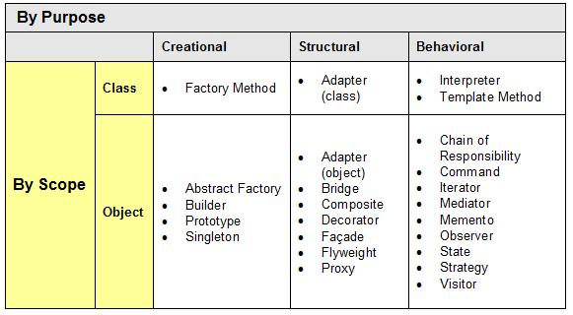
GOF Design patterns
In the figure below you find an overview of all GOF design patterns. In this lesson we will concentrate on 4 of these patterns:
Singleton
Observer
Strategy
Decorator

Slide 11
Singleton (object - creational)
Movie
Singleton Pattern:
Issue: How can you ensure that only one instance of a class is created?
Solution: Give the class a private instance of itself and a private constructor. You can only access the private instance through a public method. This method creates the instance if it is null, and then passes this single instance.
Note: only use this pattern if you are 100% sure that only one object of your (singleton) class is needed at any time.

Slide 12
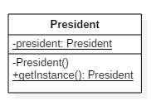
Singleton - code example

Slide 13
Singleton - code example
public final class President {
private static President
private President() {
System.out.println("A singleton object is created.");
}
public static President getInstance() {
if (president == null) {
president = new President();
}
return president;
}
}

Slide 14
Singleton - code example
President first, second;
first = President.getInstance();
second = President.getInstance();
If (first==second){
System.out.println("The two singleton variables refer to the same object.");
}
else {
System.out.println("This is not possible in principle.");
}

Slide 15
Design patterns - other
Singleton is the simplest design pattern, but not the only one...
Me: So! Have you ever heard of a book called Design Patterns?
Them: Oh, yeah, um, we had to, uh, study that back in my software engineering class. I use them all the time.
Me: Can you name any of the patterns they covered?
Them: I loved the Singleton pattern!
Me: OK. Were there any others?
Them: Uh, I think there was one called the Visitater.
Me: Oooh, that's right! The one that visits potatoes. I use it all the time. Next!!!
I actually use this as a question now. If they claim expertise at Design Patterns, and they can ONLY name the Singleton pattern, then they will ONLY work at some other company.

Slide 16
Observer (behavioural)
Video (up to minute 14, you may skip the part that follows about threats)
Observer Pattern:
Customer's dilemma: How can multiple objects be kept informed about the state of one particular object?
Solution: We call the object in which the other objects are interested "subject". This "subject" keeps a list of all interested objects, which we call "observers". The "subject" notifies the "observers" automatically about every state change with a method call (in our example update())

Slide 17
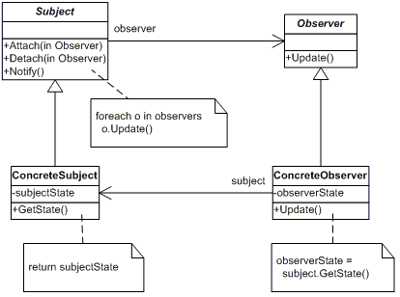
Observer pattern - general
Class diagram observer pattern

Slide 18
Observer pattern - general
Details observer pattern:
Subject: abstract class or interface to maintain list of observers, can add and remove observers
Attach - add the observer (in the parameter) to the ArrayList of observers
Detach - remove observer (in the parameter) from the observers ArrayList
Notify - notify all observers in the ArrayList of a change by looping through all observers in the ArrayList and calling the update function of each object in the ArrayList
ConcreteSubject inherits/implements subject and contains the state that the observers are interested in. Sends notification to all observers by calling the notify function (see Subject class) when the state changes (setState).
getState - Returns state of subject

Slide 19
Observer pattern - general
Details observer pattern (continued):
Observer abstract class or interface, defines an updating method for all observers so that they can receive an update notification from subject.
update - abstract function, will be overridden by concrete observers
ConcreteObserver keeps a reference to subject in order to be able to retrieve the state of subject when he receives a notification
update - (overriding) When the subject calls this function, the concreteObserver calls the getState operation of the subject in order to obtain information about its state.

Slide 20
Observer pattern - example code
You can check the example code from the video here:
http://www.newthinktank.com/2012/08/observer-design-pattern-tutorial/

Slide 21
Strategy (behavioural)
Movie
Strategy Pattern:
Customer's dilemma: How can you ensure that at runtime it can be decided which algorithm should be used to determine the output of a particular method?
Solution: Define, using an interface, a family of algorithms that each give a different implementation to one particular method.

Slide 22
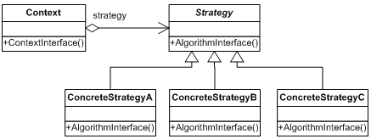
Strategy pattern - general
Class diagram strategy pattern

Slide 23
Strategy pattern - general
Strategy abstract class or interface for the algorithm/strategy of which all concrete algorithms inherit. It provides a common interface for all the concrete algorithms/strategies. All the abstract functions of the Strategy class must be overridden by the ConcreteStrategy classes.
ConcreteStrategy In this class we implement the algorithm.
Context can be configured with one or more ConcreteStrategies. It uses this ConcreteStrategy via the interface defined in Strategy.

Slide 24
Strategy pattern - example code
You can check the example code from the video here:
http://www.newthinktank.com/2012/08/strategy-design-pattern-tutorial/

Slide 25
Decorator (strutural)
Movie
Decorator Pattern:
Problem definition: You want the functionality of inheritance but you want to be able to change this @runtime. You want to dynamically assign responsibilities (methods) to an object.

Slide 26
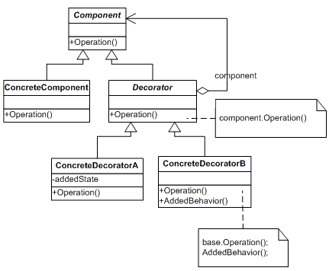
Decorator pattern - general
Class diagram decorator pattern

Slide 27
Decorator pattern - general
Component abstract class or interface that defines an interface for components.
ConcreteComponent concrete implementation of the component class. Defines an object to which additional responsibilities / properties can be assigned.
Decorator inherits attributes and operations from a Component and maintains a reference to an object of the class
ConcreteDecorator This is the class that we use to assign additional responsibilities, additional properties and/or other versions of existing responsibilities to a component.

Slide 28
Decorator pattern - example code
You can check the example code from the video here:
http://www.newthinktank.com/2012/09/decorator-design-pattern-tutorial/

Slide 29
Assignments on Canvas
Assignment design patterns 2021-2022
Goal = get design patterns working in a restaurant application
In the start folder you will also find in Canvas, the tests that should all pass if you have implemented the design patterns correctly
Assignment web application
Objective = to create a web application with the technology you have learned in the lessons
Start = the project in which you got the design patterns working
Tips
Make regular backups and new versions as soon as you have updated a functionality, so that you can always fall back on a working project.
GOOD LUCK

